Slide 1
Tutorial 8 Generics

Slide 2
Exercise 1
Write a java program to create the Generic Interface Queue that describes 2 functions : put() and get(). Handle your own exceptions for these methods based on Queue full and Queue empty conditions. Define the class which implements this interface and demonstrate its working in main().

Slide 3
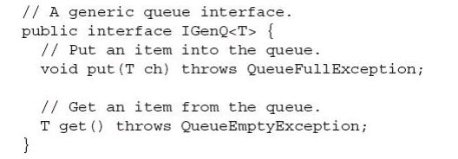
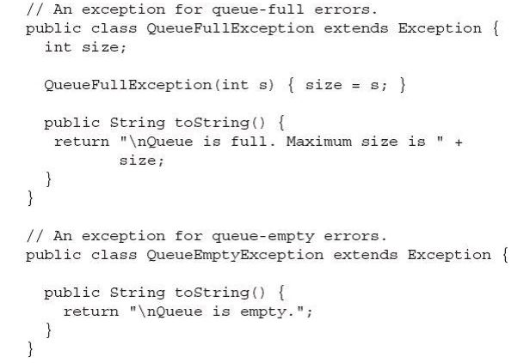

Slide 4
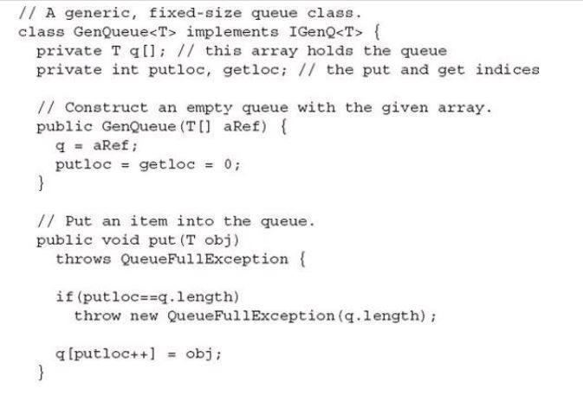
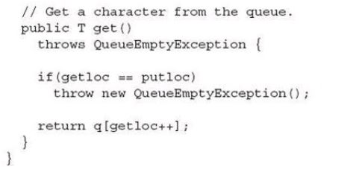

Slide 5
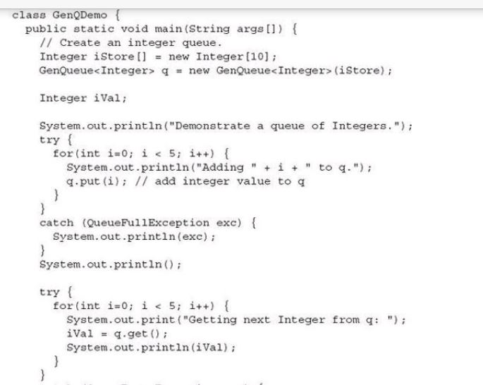

Slide 6
Exercise 2
Write a java program to demonstrate the Generic class to implement the functionality of a Doubly linked list for any of data.

